Slide 1


ZONTM Control for users

Slide 2
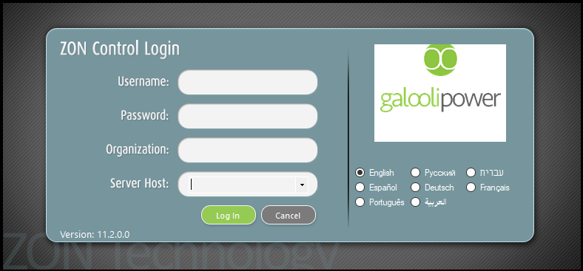
Setup
http://zondeploy.dnsalias.com/zoncontrol/zonControl.application
PC Hardware requirements | Operating system requirements
Processor – 1GH_{Z} | Windows – XP and up
Memory: _{RAM – 512 MB} _{Hard Disk – 32 bit -600 MB} _{Hard Disk – 64 bit -1.5 GB} | NET Framework - Version 4.0 and up

Slide 3

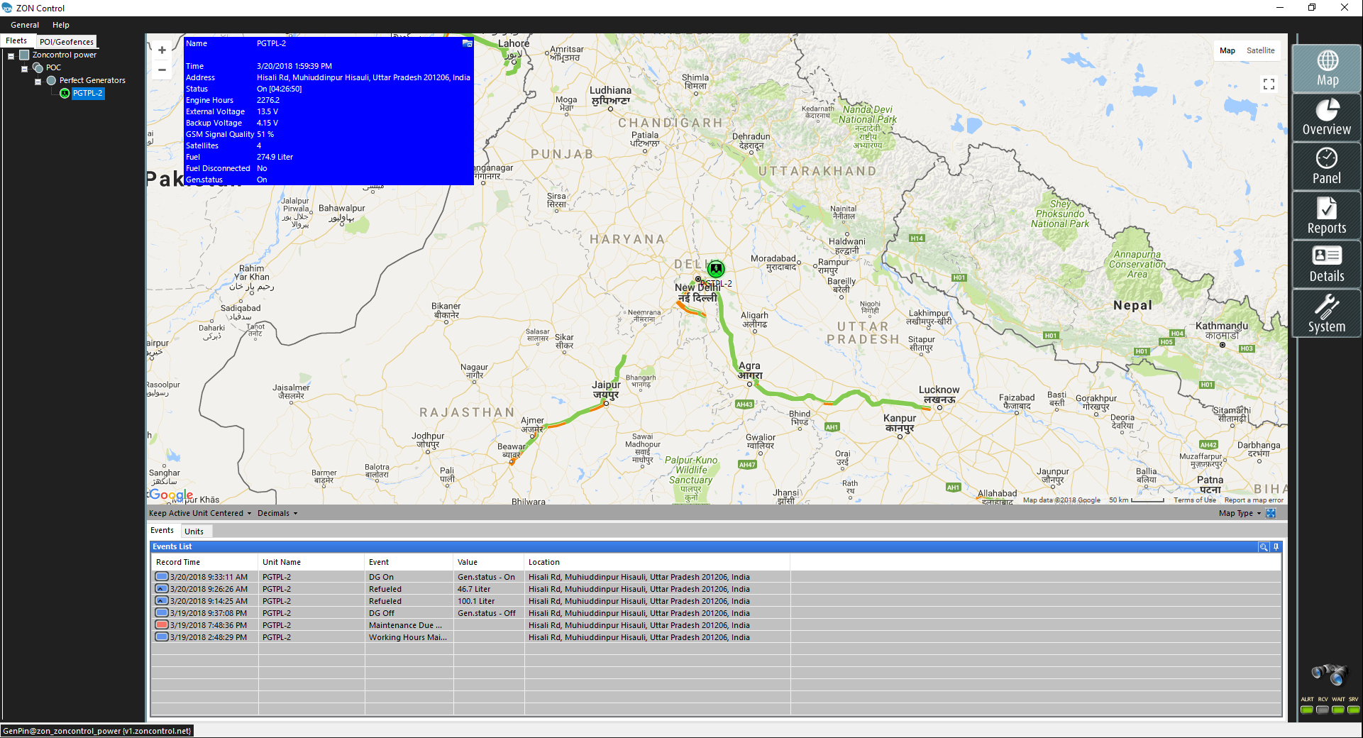
Overview
ZONTM Control is Galooli’s user application for PC that shows all of the connected assets live and history data.

Slide 4
Main Features
Real time management and tracking of assets.
Fuel management (theft detection, refueling, fuel consumption, ongoing fuel level and more).
Variety of asset sensors (Ignition, doors, cooling cabin, access control and other inputs).
Engine diagnostics.
Real time dynamic control panel.
User defined areas of interest (Geo-fencing) – Radius, polygon, routes, and POI’s (customers, suppliers, offices, etc).
User defined automatic alerts.
Send alerts through e-mail accounts and mobile phones (SMS).
Highly detailed, custom made, Operational and statistical reports.
Advanced authorization module for users management

Slide 5
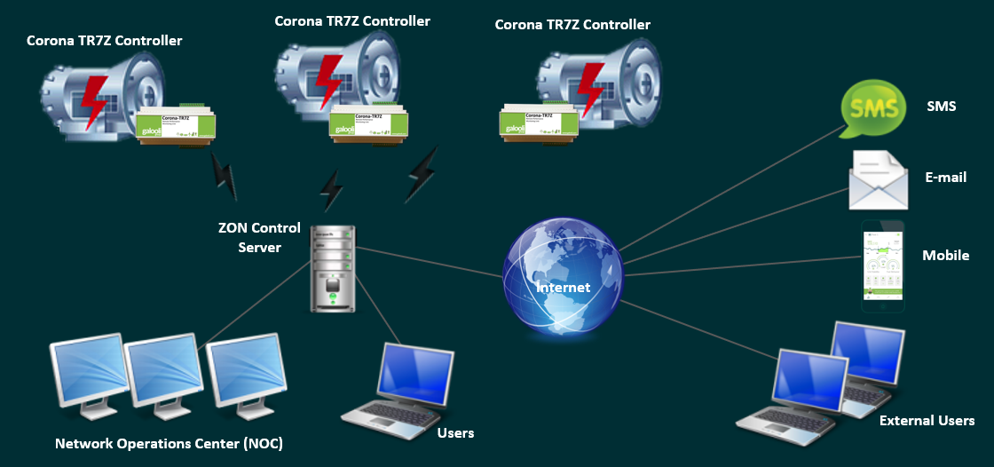
System Architecture
The ZON™ Control Solution is composed of 4 major sub systems:
End units – The End Units are installed on the monitored asset, collect various sensors information available, performs on board processing and communicates the data to the main ZON server.
Servers – Application and Database Server provide full control over the end units, communication management, mapping data and users’ control.
ZON™ Control back office – The Back Office application is used from any remote PC (pending user authorization) and provides full management capability for each and every asset under the same platform.

Slide 6
Basic Terminology
User – Unique credentials to login and use ZON™ Control. The level of authorizations is granted by the user creator (administrator).
Asset - An asset is a resource belonging to the client. An asset can be mobile or stationary such as a vehicle, generator or a telecom site. An end device must be installed and configured on the asset.
Unit - A Unit is an entity representing the asset in the system.
Organization Tree – In order to manage multiple assets, the ZON™ Control system maps out the assets in a basic hierarchy structure. The hierarchy levels are: Organization > Fleet > Group > Unit. There is no limit to the number of Fleets, Groups and units an authorized user can add. The hierarchy structure is used to create virtual separations which helps managing multiple number of assets.
Event - An event is an occurrence detected by the server such as Unit status change. The user can define automatic alerts and actions that will be activated when a specific event occurs, such as empty fuel tank. The user can be notified about the event occurrence by a 'Pop-Up', e-mail or SMS
POI / Geo-fence - A POI is a Point Of Interest and a Geo-fence is a virtual perimeter for a real-world geographic area. The user can create a location-based event of a Unit detected in a POI or a Geo-fence.

Slide 7
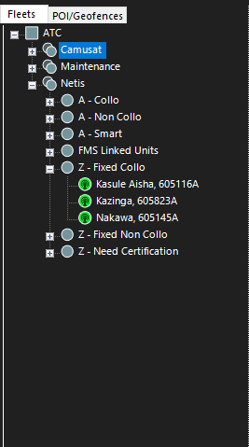
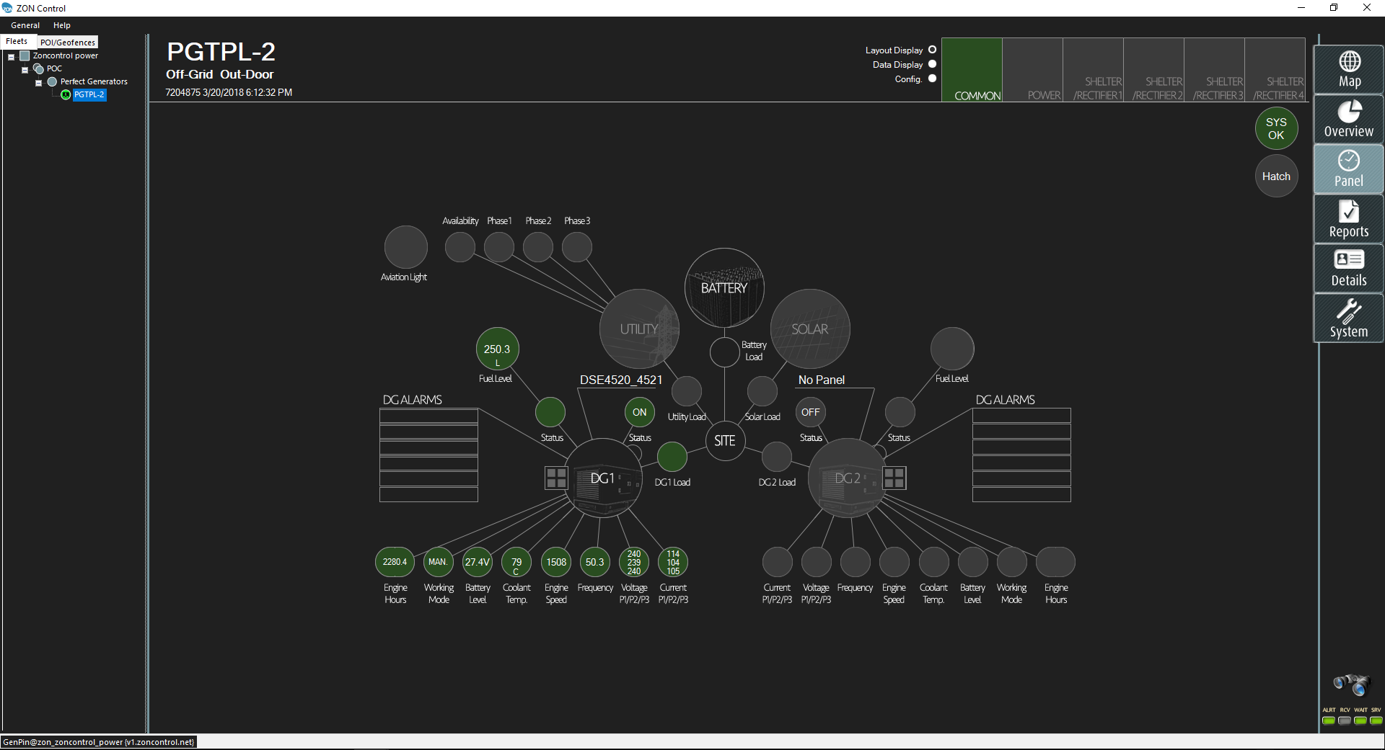
Organization Tree
Organization name
Fleet
Group
Unit
Group

Slide 8
Main Tabs
Map display
BI Dashboards
Unit Real time panel
Reports: detailed, summary, events, asset
Summarized display of the organization/fleet/group/unit, service logs
Users management, calibration tables

Slide 9
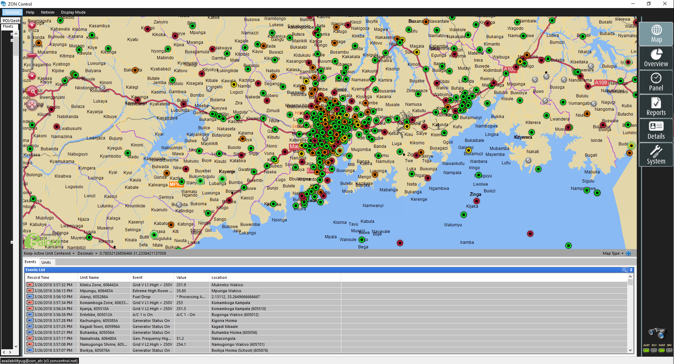
Map Display
Sites displayed on the map according to their location.
2 options for site color icon:
According to the status of the alarms at site
According to the status of the Generator
2 display options:
Events of last week from the entire organization
List of the units in the organization

Slide 10
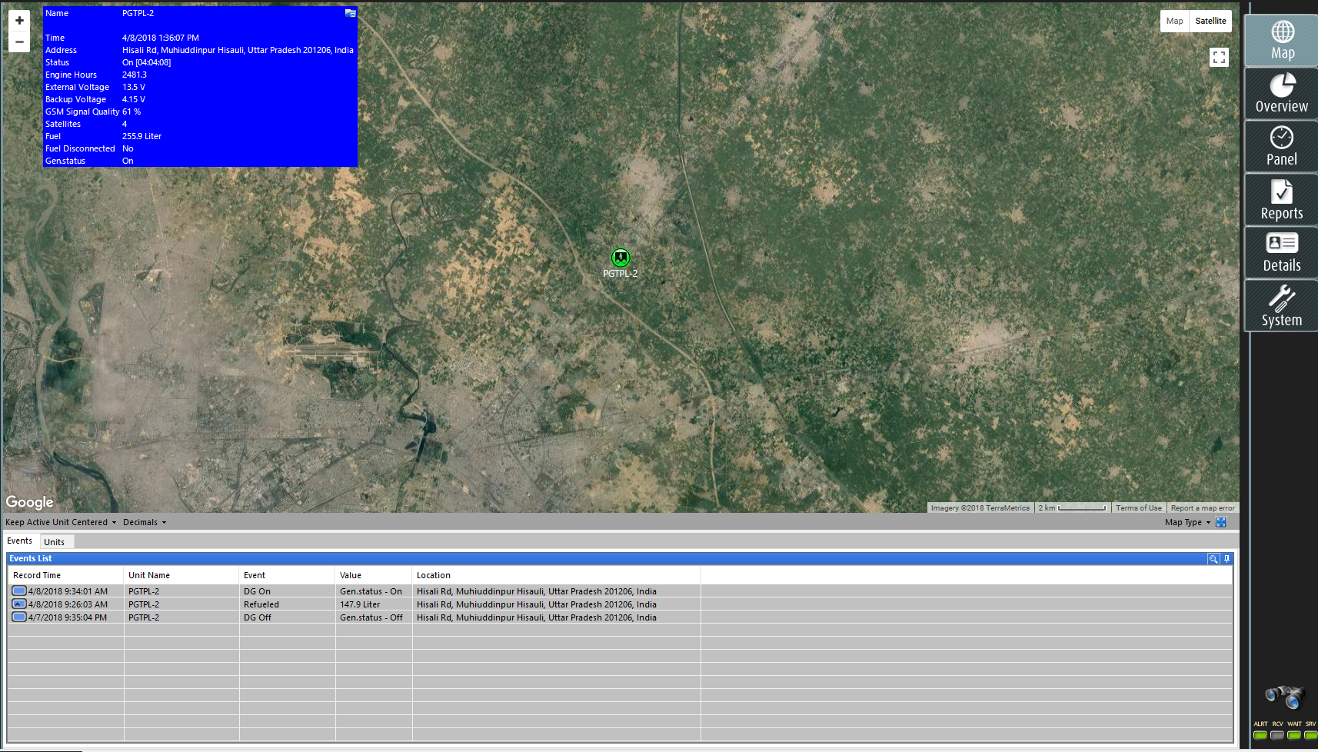
Map Display – Data Box
The Real Time Data Box (“Blue Window”) is constantly synced presenting valid data on a regular basis.
Minimize / Maximize the window by clicking on

Slide 11
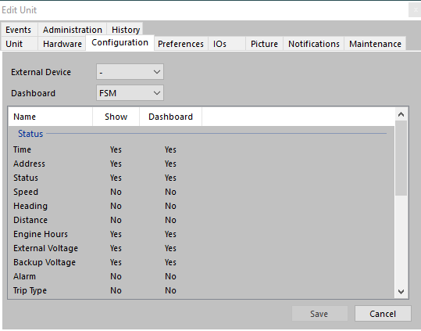
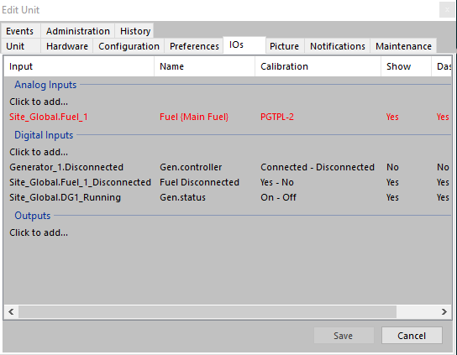
Map Display – Data Box
To configure the display right-click / double-click on the unit and click Edit Unit Configuration tab and IOs tab
Click “Yes” under Show column in line with the requested parameter. For IOs it is needed to add the input before it can be selected for view

Slide 12
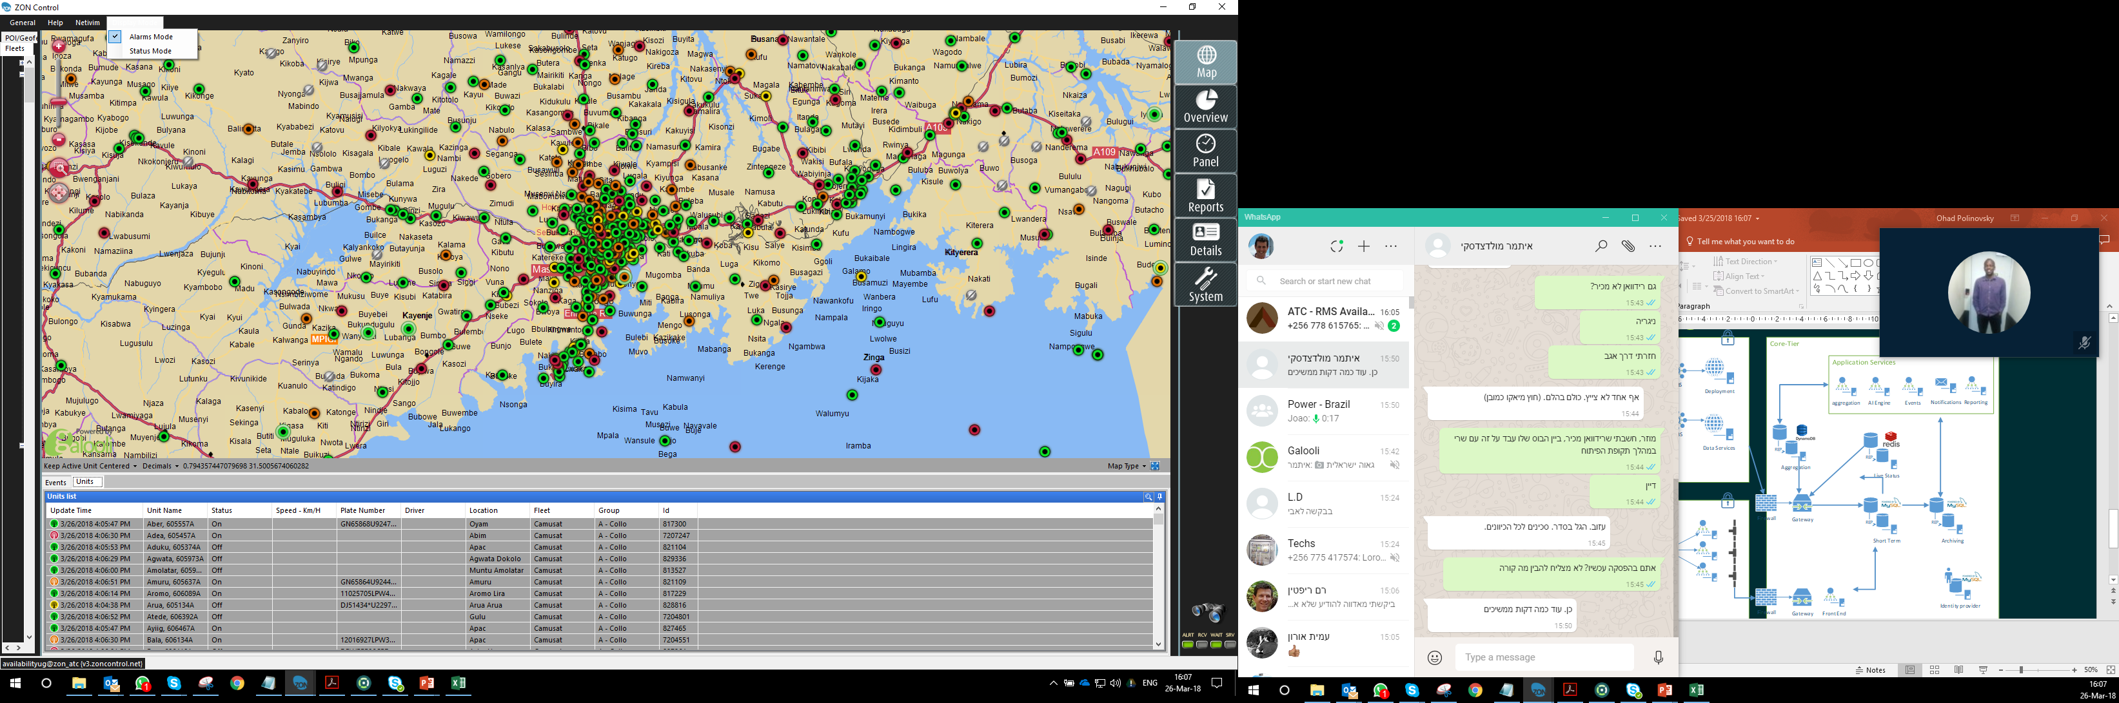
Map - Color code
Switching between the display option
Alarms Mode
Red = critical
Orange = urgent
Yellow = non urgent
Green = no alarm or indication alarms
Grey = unit is disconnected
Status Mode
Green = Generator is running
Yellow = Generator is not running
Grey = unit is disconnected

Slide 13
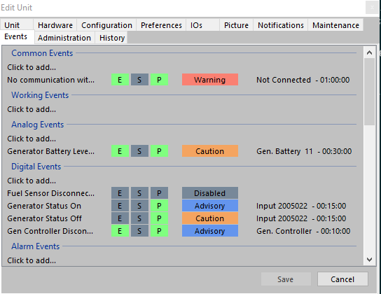
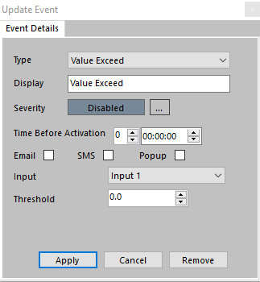
Events
2
On each digital or analog parameter that exists in the system an event can be defined
To configure an event follow the following steps:
Double click the unit to edit the unit or right click on the unit and select edit unit
Select the events tab
Chose the type of event you would like to configure (Digital/Analog/Fuel etc.)
Click to add…
Select the type of the event
Edit the event display name
Define the severity of the event
Define delay time before the events trigger after the condition become active
Select in which method to receive the event
Select the relevant parameter for the event
Define the threshold
4
5
6
7
8
9
10
11

Slide 14
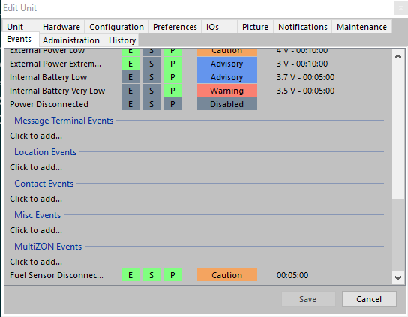
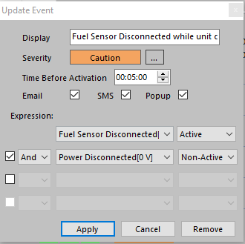
Multi ZON Events
Enable to combine 2 or more conditions in one event
To configure a multi zon event follow the following steps:
Define the events that will use as the conditions for the multi zon event.
Click to add under multiZON events
Define the display name/ delay time and way of notification of the event
Select the relevant events and the conditions between the events
2
3
4

Slide 15
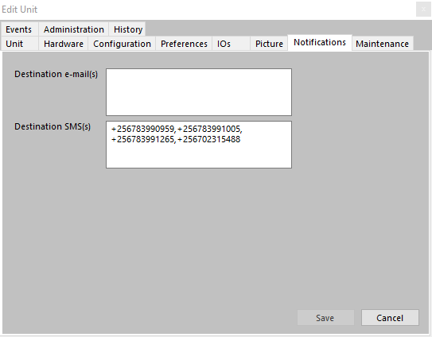
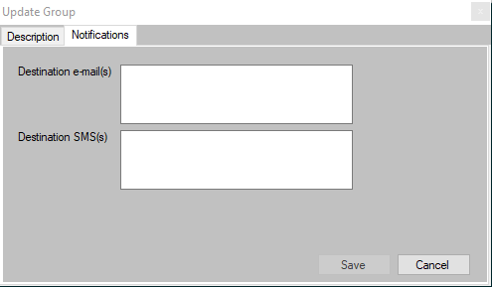
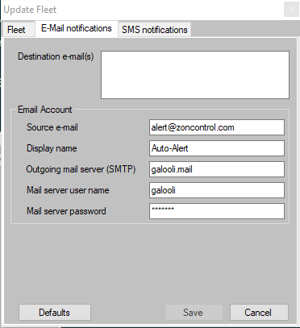
Events Notifications
Can be defined from the unit level up to the organization level.
A notification will be sent to any recipient defined if any event is triggered in any of the unit below the place the notification was defined in
In order to define select the notification tab where you plan to define it
For SMS notification it is not enough to enter the numbers, it must be done in coordination with Galooli.
Unit Level
Group Level
Fleet Level

Slide 16
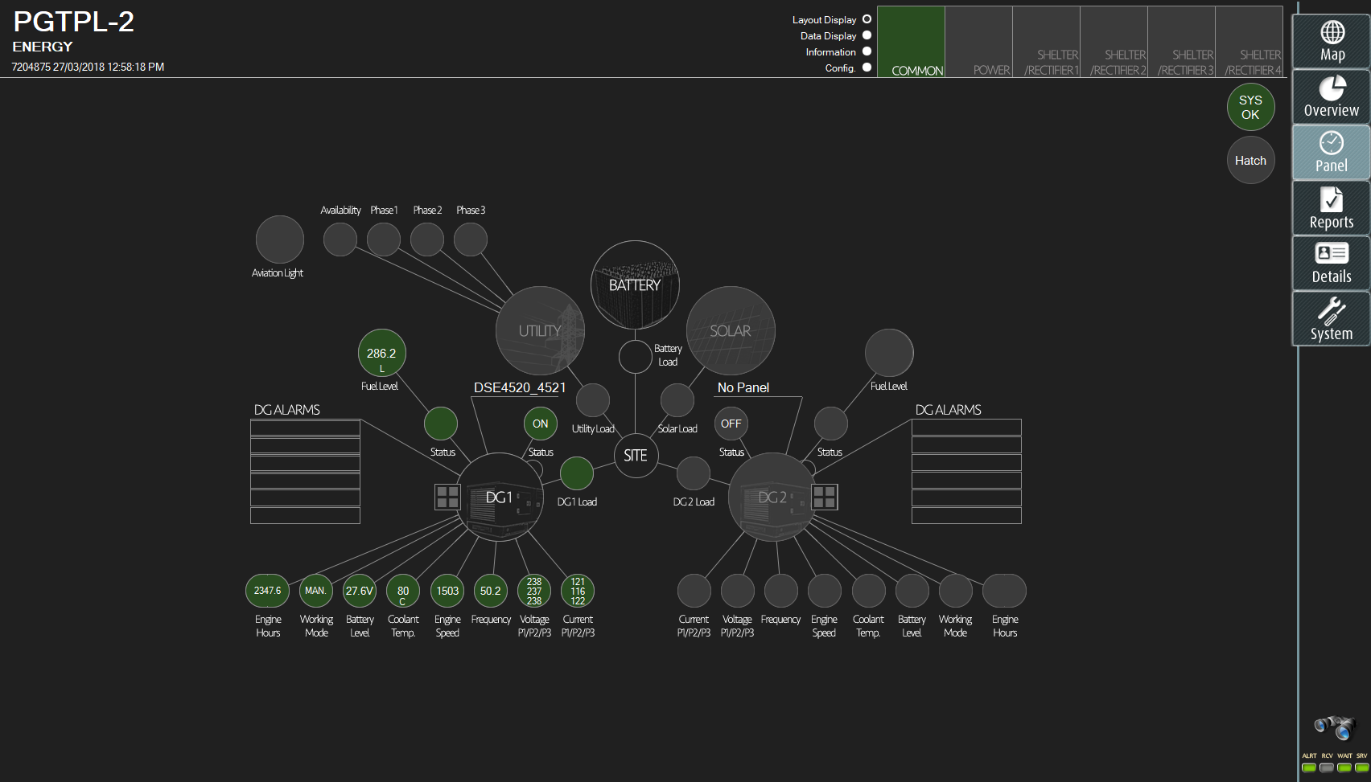
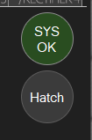
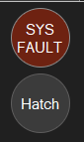
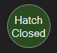
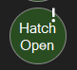
Panel Display - General
Unit and sensors communication is ok
One of the sensors is disconnected
Unit’s hatch (if installed door sensor) is closed
Unit’s hatch is open
Black = Asset/equipment exist on site an configured in the unit
Grey = Asset/equipment does exist on site or is not configured in the unit
Search button
Unit Name
Layout
Unit id
Server communication indicators
ALRT – turns red when an event in one of the units in the organization become active, otherwise it is green
RCV – information received from the server, otherwise it is grey
WAIT – waiting for confirmation from the server
SRV – Blinks between green and grey when the communication with the server is ok. Will become red when there is no communication

Slide 17
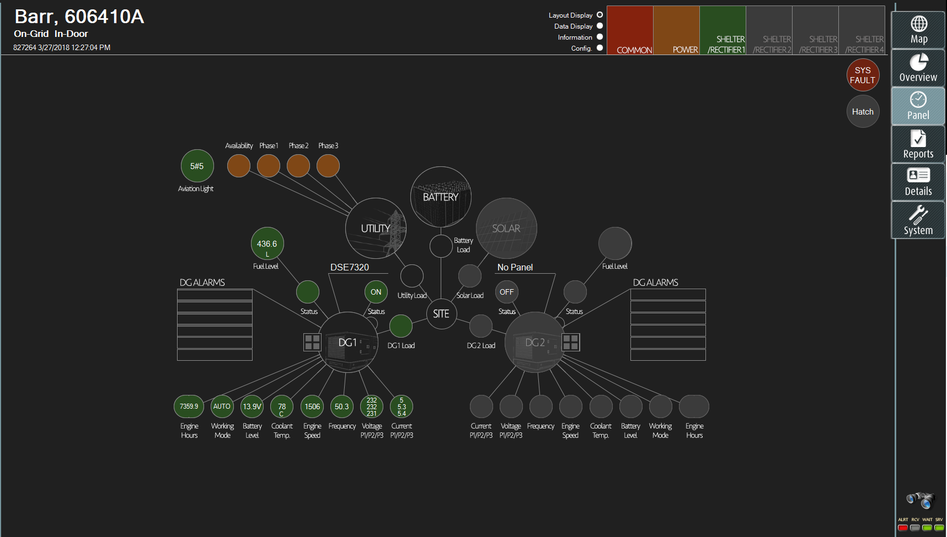
Panel Display
Dashboards view
Parameters values display in a list
Dedicated section to add manually fixed parameters relevant to the asset
Configuration of the relevant parameters for accurate display
Available windows showing each deafferent display.
Switching between the tabs by selecting the requested window with the indicator.
Color logic is the same as in map display.

Slide 18
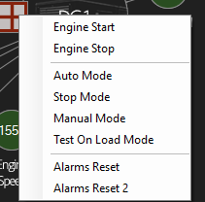
Panel Display - Common
Site’s passive equipment overview
Fuel level
Generator status
Remote control menu
Generator parameters

Slide 19
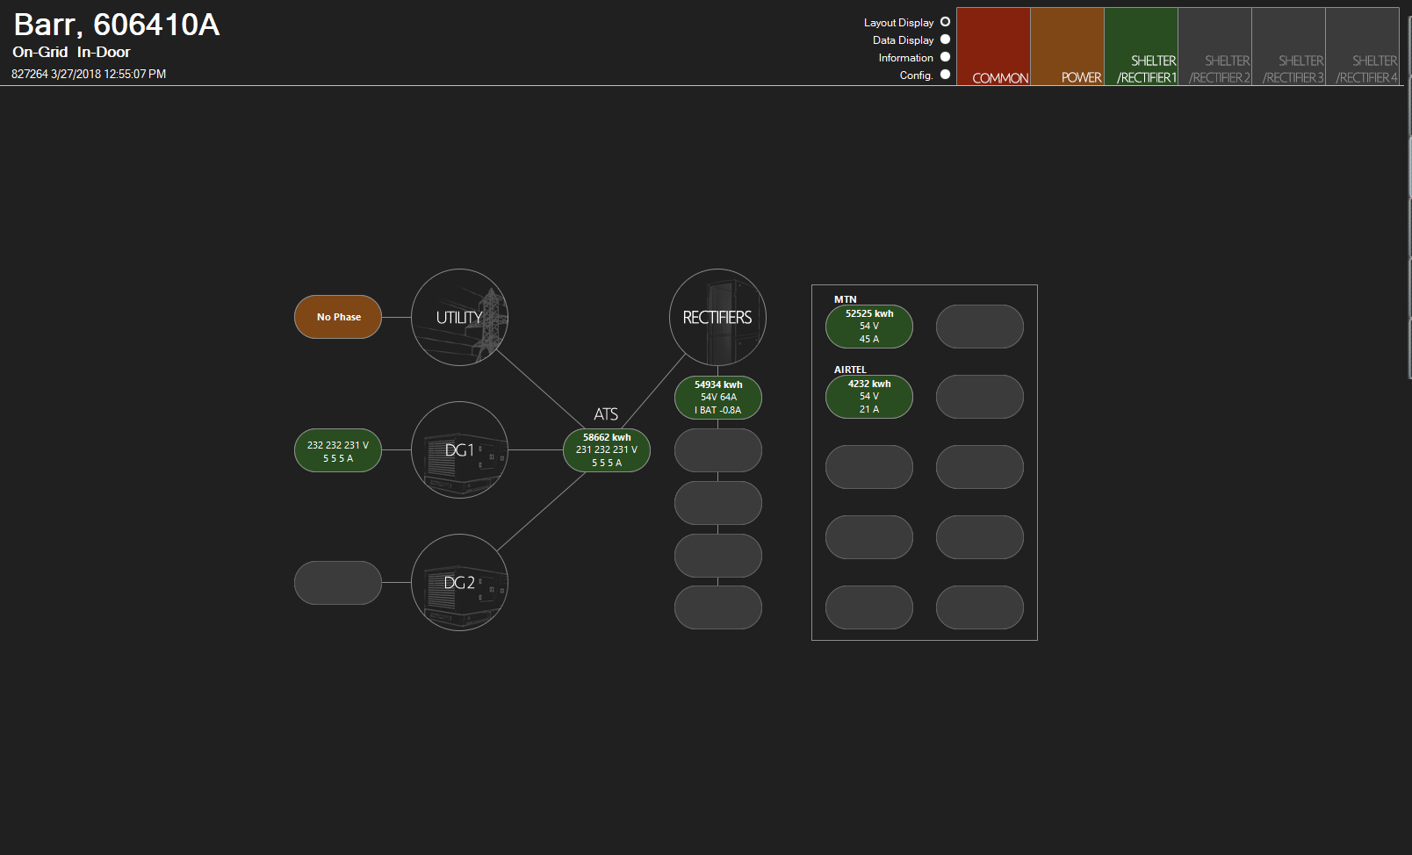
Panel Display - Power
All relevant power information of the site (Voltage, Current and Kwh)
Tenants power consumption

Slide 20
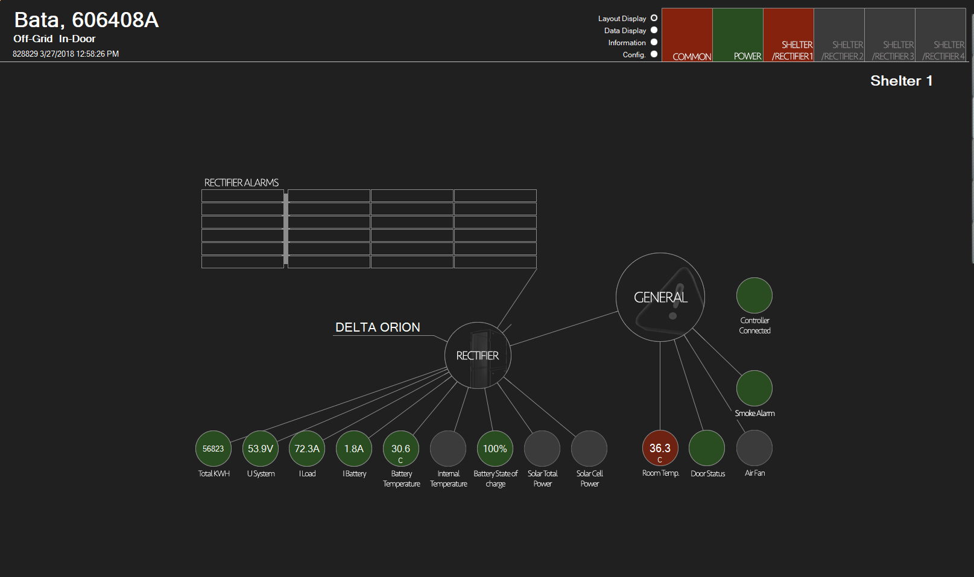
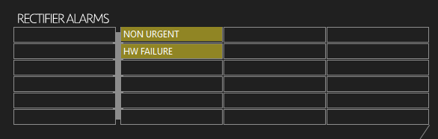
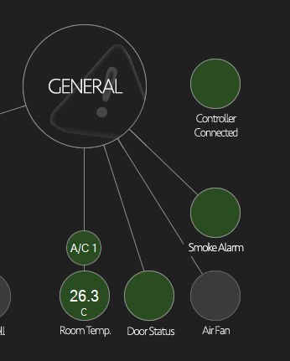
Panel Display – Shelter/Rectifier
Rectifier plus environmental information
Supports up to 4 rectifiers and/or equipment rooms
Rectifier alarms
Rectifier type
HVAC
Rectifier parameters

Slide 21
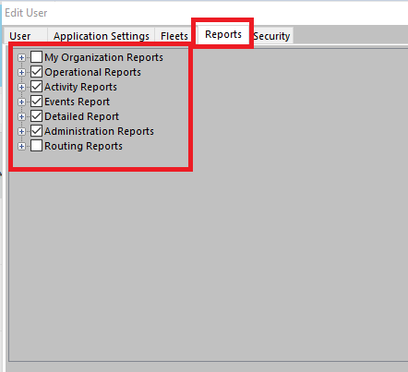
How to enable reports in the system?
In order to allow a user to view reports in the system, this should be enabled in his user settings on ZON Control.
This allows a particular user to see only a particular type of report, or only specific group of reports or specific built in reports.

Slide 22
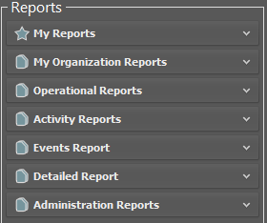
Report Types
There are several report’s sections in the system. We will focus on the main and most useful reports of our daily work.

Slide 23
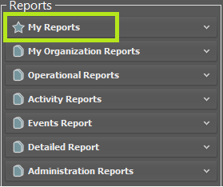
My Reports
Reports the user creates for themselves and saved locally on their machine
The user reports can be usually found at:
Documents - >The ZON Pro -> Report Favorites

Slide 24
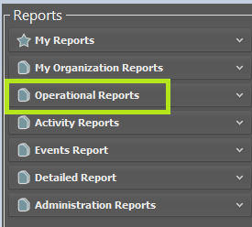
Operation Reports
Reports which summarizes data from 24 hours or more. These reports can be applied for a single site/ group of sites, fleet or the whole organization.

Slide 25
Operation Reports
Reports which summarizes data from 24 hours or more. These reports can be applied for a single site/ group of sites, fleet or the whole organization.

Slide 26
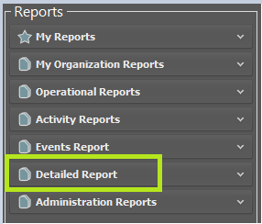
Detailed Reports
Reports that allow the user to view unit’s data per transmission. These reports can only be applied to a single unit and not to a group of units.

Slide 27
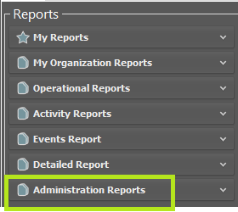
Administration Reports
Allows the user to view which information was defined in the ZON Control system. This data can be applied to a single unit or a group of units.

Slide 28
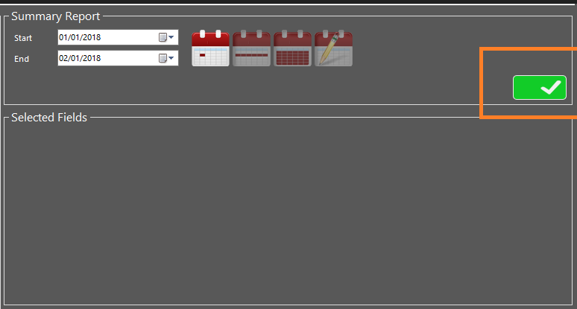
Report Structure
As a rule, any information in the system can be generated by the report generator. However, you should know which data is relevant to each report type.
In some reports, such as operational reports and detailed report, it is a must to choose time range for the requested data.
Regardless, it is possible to run/generate a report only when you see the green mark at the top of the screen

Slide 29
How to Build Reports in the System
The built-in reports, could serves the user as a good basic for every kind of report he wishes to generate.
User can add/remove fields from an exist report.
All the available fields for the report are available at the bottom of the screen. The fields are divided into several tabs.
Under each tab, you can find the fields which are relevant to the tab’s subject.
Some of the field names are not "user-friendly" and require prior familiarity with the system in order to locate them
There is also a search option, to make it easier to find field’s names.

Slide 30
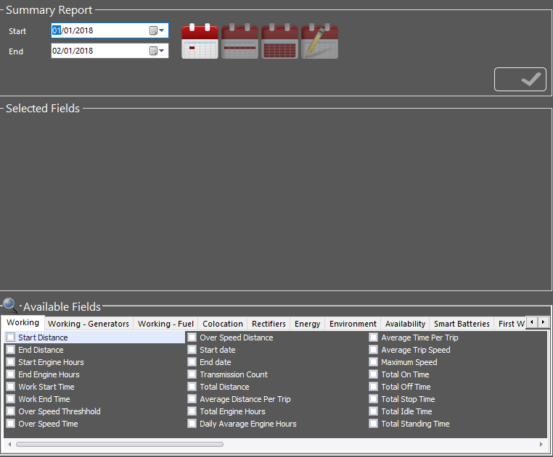
How to Build Reports in the System
Date/Time settings
Data Fields

Slide 31
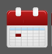
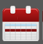


How to Build Reports in the System
Next to the report’s Date/Time setting, there are 4 “calendars”. Each calendar defines the visibility of data in operational report (only):
Daily – display separate raw for each day in the selected period
Weekly – display separate raw for each week in the selected period
Monthly – display separate raw for month day in the selected period
Selected Period – display one raw for the whole selected period only

Slide 32
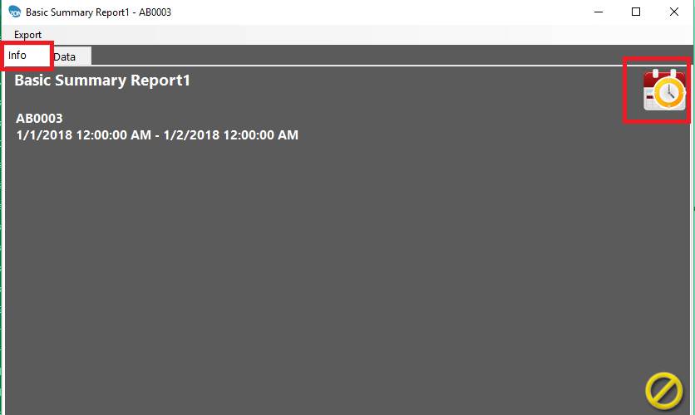
Scheduled Reports
It is possible (and recommended) to schedule reports.
Before scheduling, you must verifying that e-mail settings are defined on the relevant group.
Scheduling a report could be carried out only after the report is generated manually.
To schedule a report, navigate to “Info” tab, and press the calendar/clock icon. Use the Scheduling Wizard to schedule the report according to your preferences

Slide 33
Common Faults

Slide 34
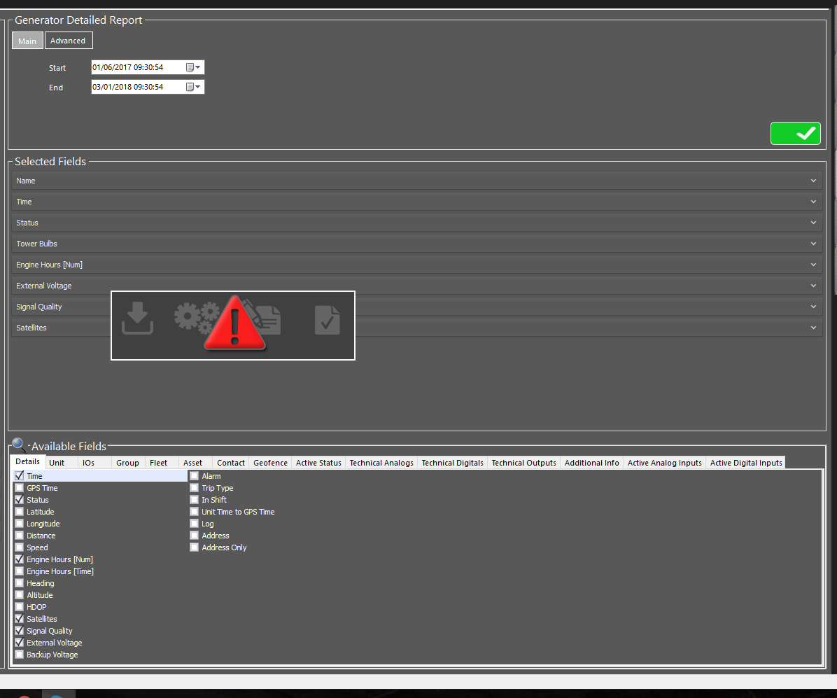
Red Triangle
The report’s system has a "time limit" for running a report. If the report running exceeds the time limit, a red triangle will appear
Ways of handling:
Reduce the report time range
Running the report out of the peak hours (night, weekends)

Slide 35
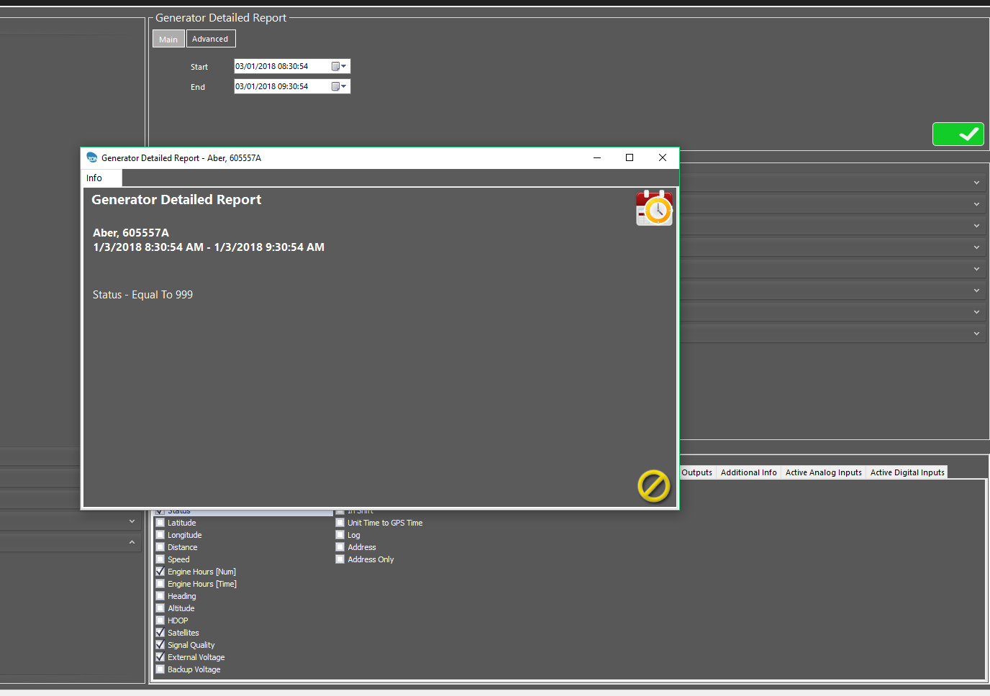
Exception Notification
Caused by a field mismatch for the report type, or that the system did not find the requested / defined data
Ways of handling:
Check for filtered field that could prevent the system to generate the report.

Slide 36
Features

Slide 37
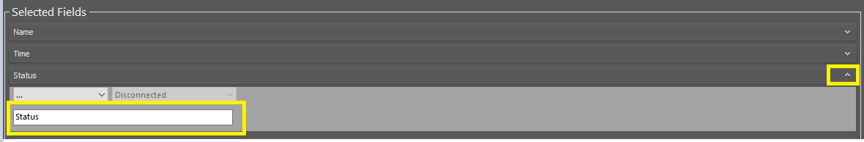
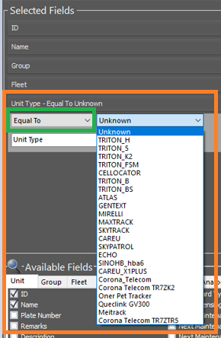
Rename Field
Change Field’s name – every field can be renamed. Open the line of the requested field, and change the field’s name at the name line
Filtering data by field – every field could be filtered, so you will get the relevant data only. It is possible to filter numbers, names, layouts, status, time, and many more. Filtering could make the report more specific and with the most valuable data

Slide 38
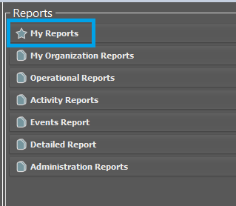
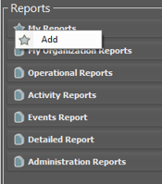
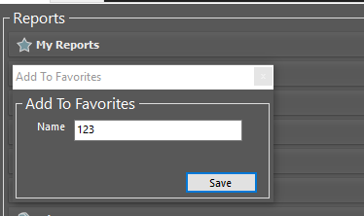
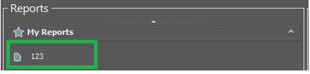
Adding Reports to Favorites
To save a report locally on your computer:
Generate a report in the system
Under the reports header, right click the star on the left hand side of “My Reports” section
Click “Add”
Name the report
Click save
The report will be save under “My Report” section

Slide 39
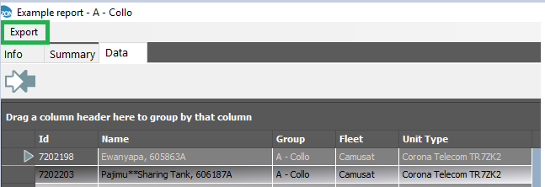
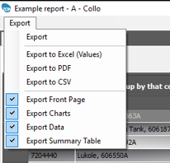
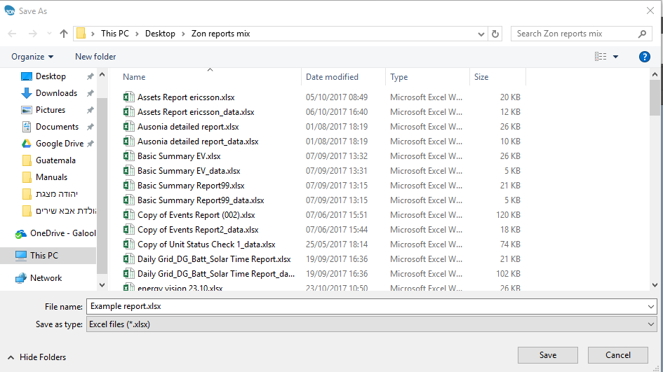
Export Reports
Steps for exporting:
Generate a report
Click “Export” at the top of the report
Choose the format you wish to export to, and the pages you whish to be exported (Front page/Data/Charts)
Choose you preferred location to save the reports on your computer.
Click “Save”

Slide 40
Proper and Efficient Use of Reports
Prefer to work from wider to detailed.
Prefer to run detailed reports only for the relevant period for investigation rather than over a wide and irrelevant range.
Prefer to include only the relevant data in the report . Any additional data is liable to “weigh” on the amount of data in the report and to slow the pace of its production.

Slide 41

User Management
Users can be added and configured from the Details display. Click Details and then Users tab to view the users list.
The users list shows all your users including their personal information such as name, phone and email as well as their authorization type

Slide 42


User Management
From the users tab, you may add, edit, clone or remove users. Right click the users table to open the user menu
Enter username and password (case sensitive)
Define user role
Define expiration date for user

Slide 43


User Management
Managers can authorize users to view specific fleets, reports or other settings within ZON Control.

